Slide 1
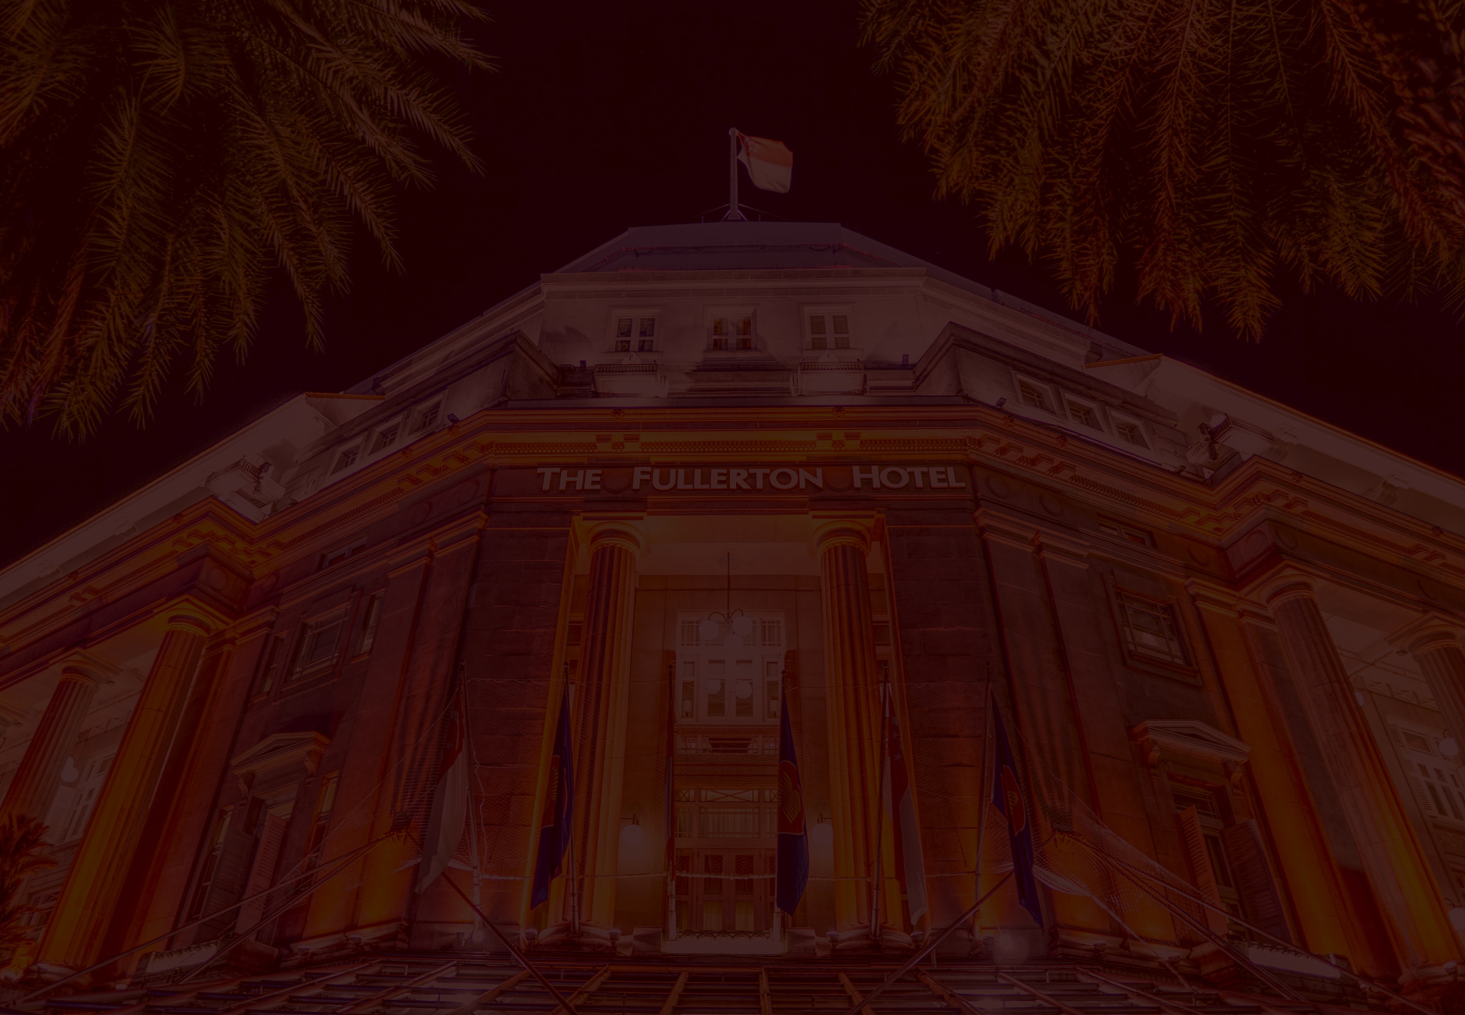


MENTORENESS
Home
Service
About Us
Contact
HOTEL RESERVATION ANALYSIS
HOTEL RESERVATION ANALYSIS WITH SQL

Slide 2

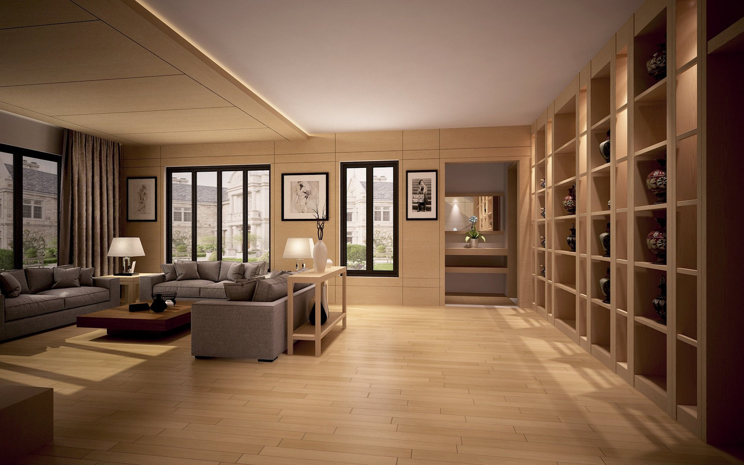
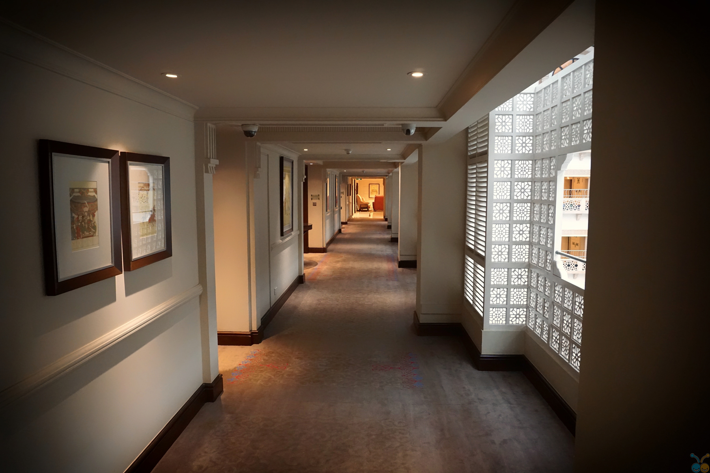
Home
Service
About Us
Contact
INROUDCTION
The hotel industry relies on data to make informed decisions and provide a better guest experience. In
this analysis, we work with a hotel reservation dataset to gain insights into guest preferences,
booking trends, and other key factors that impact the hotel's operations. We will use SQL to query and
analyze the data, as well as answer specific questions about the dataset.
03

Slide 3
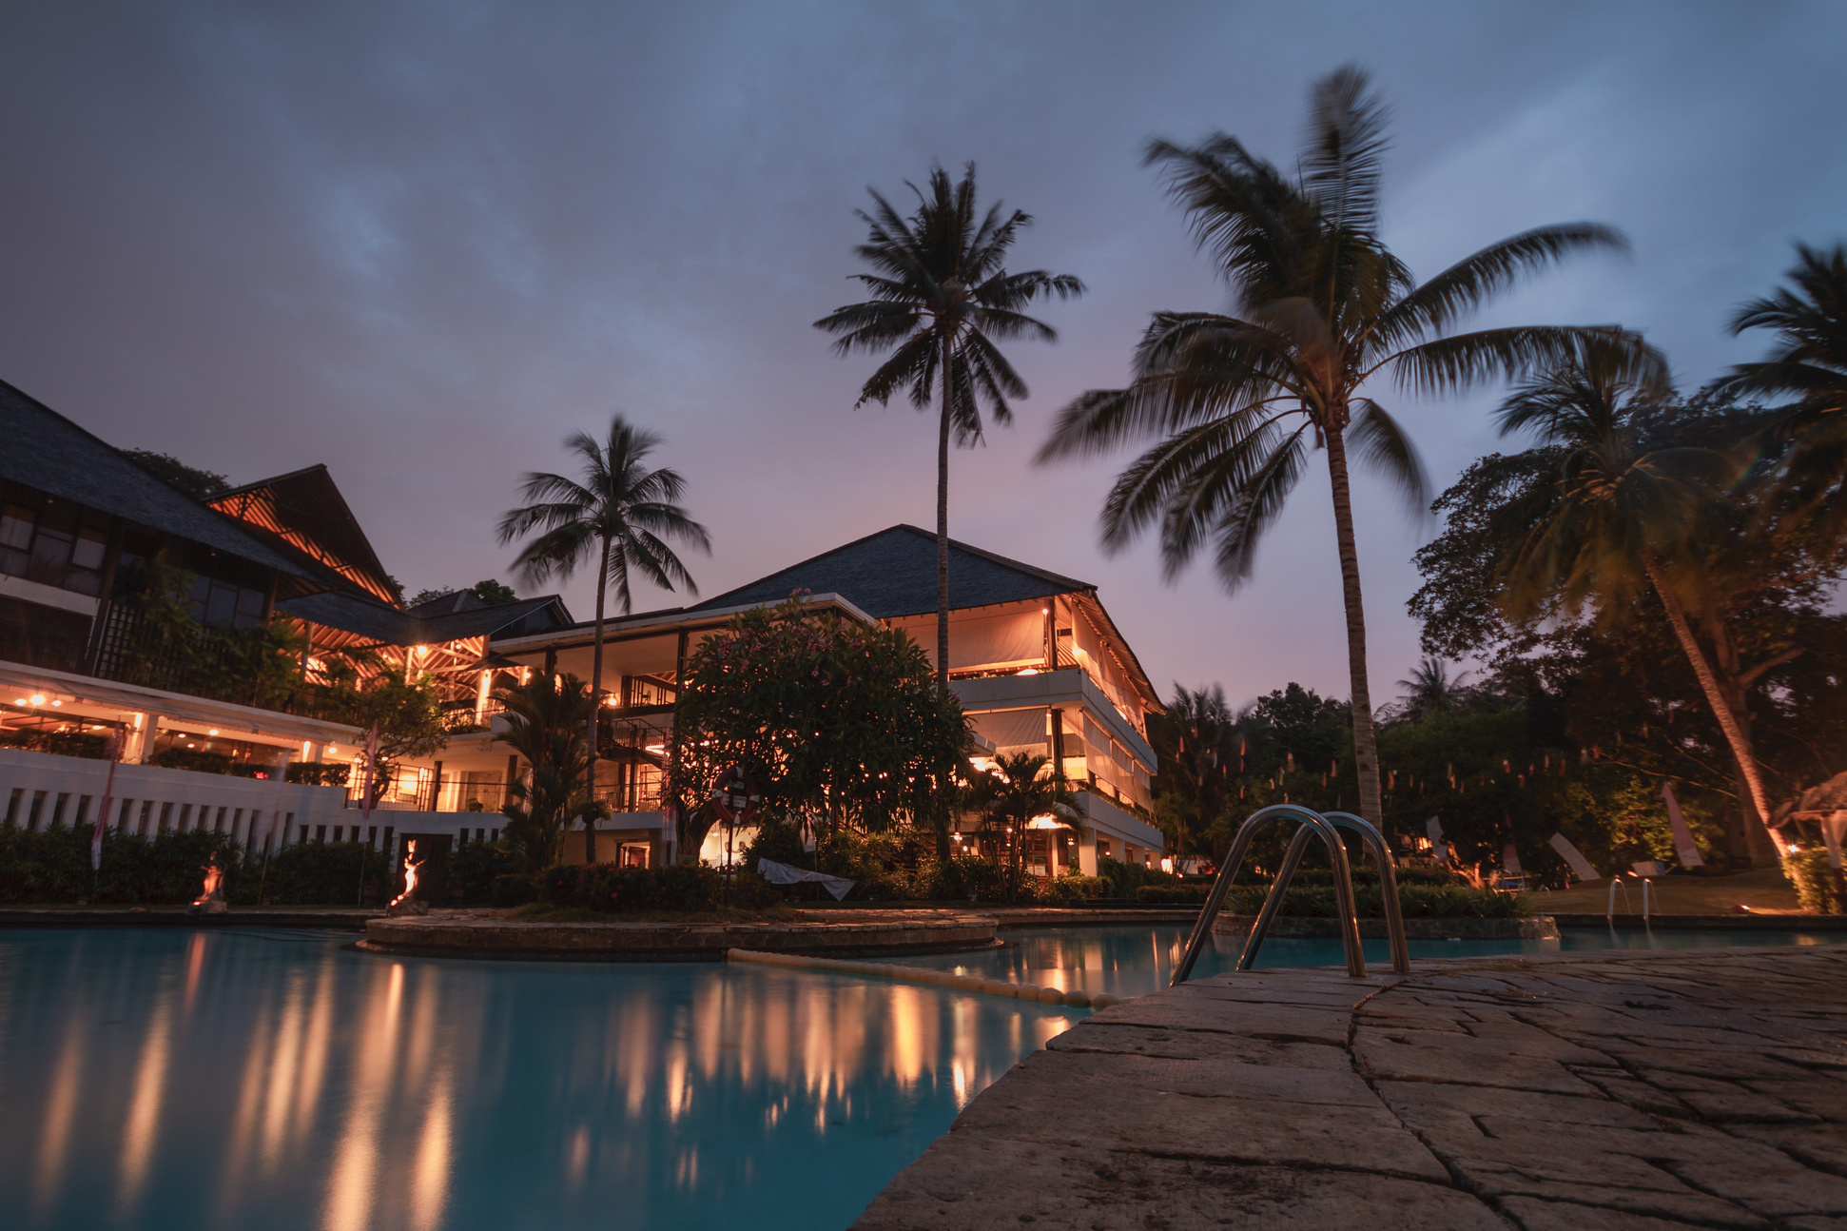
Home
Service
About Us
Contact
About the dataset
The dataset includes the following columns:
Booking_ID: A unique identifier for each hotel reservation.
no_of_adults: The number of adults in the reservation.
no_of_children: The number of children in the reservation.
no_of_weekend_nights: The number of nights in the reservation that fall on
weekends.
no_of_week_nights: The number of nights in the reservation that fall on
weekdays.
type_of_meal_plan: The meal plan chosen by the guests.
room_type_reserved: The type of room reserved by the guests.
lead_time: The number of days between booking and arrival.
arrival_date: The date of arrival.
market_segment_type: The market segment to which the reservation
belongs.
avg_price_per_room: The average price per room in the reservation.
booking_status: The status of the booking.
04

Slide 4

Why Analyse
Home
Service
About Us
Contact
Identify Trends: Understand booking patterns, such as peak booking times, popular room types, and preferred meal plans, to optimize marketing and operations.
Customer Insights: Gain insights into guest preferences and behaviors, which can help in personalizing services and enhancing guest satisfaction.
Revenue Management: Analyze lead times and average prices to optimize pricing strategies and improve revenue management.
Operational Efficiency: Identify inefficiencies and areas for improvement in the booking process, room management, and service delivery.
Forecasting and Planning: Use historical data to forecast demand, plan for busy periods, and manage resources effectively.
Market Segmentation: Understand different market segments to tailor marketing campaigns and service offerings to target specific customer groups.

Slide 5
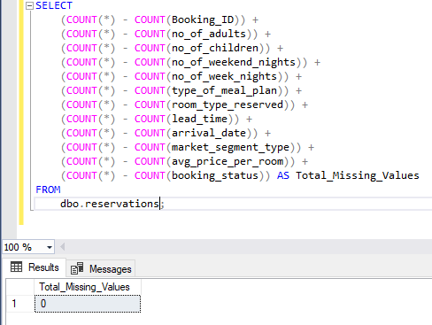
Home
Service
About Us
Contact
Check the Dataset for Null values
The dataset contains 0 null values and therefore analysis begins
04

Slide 6
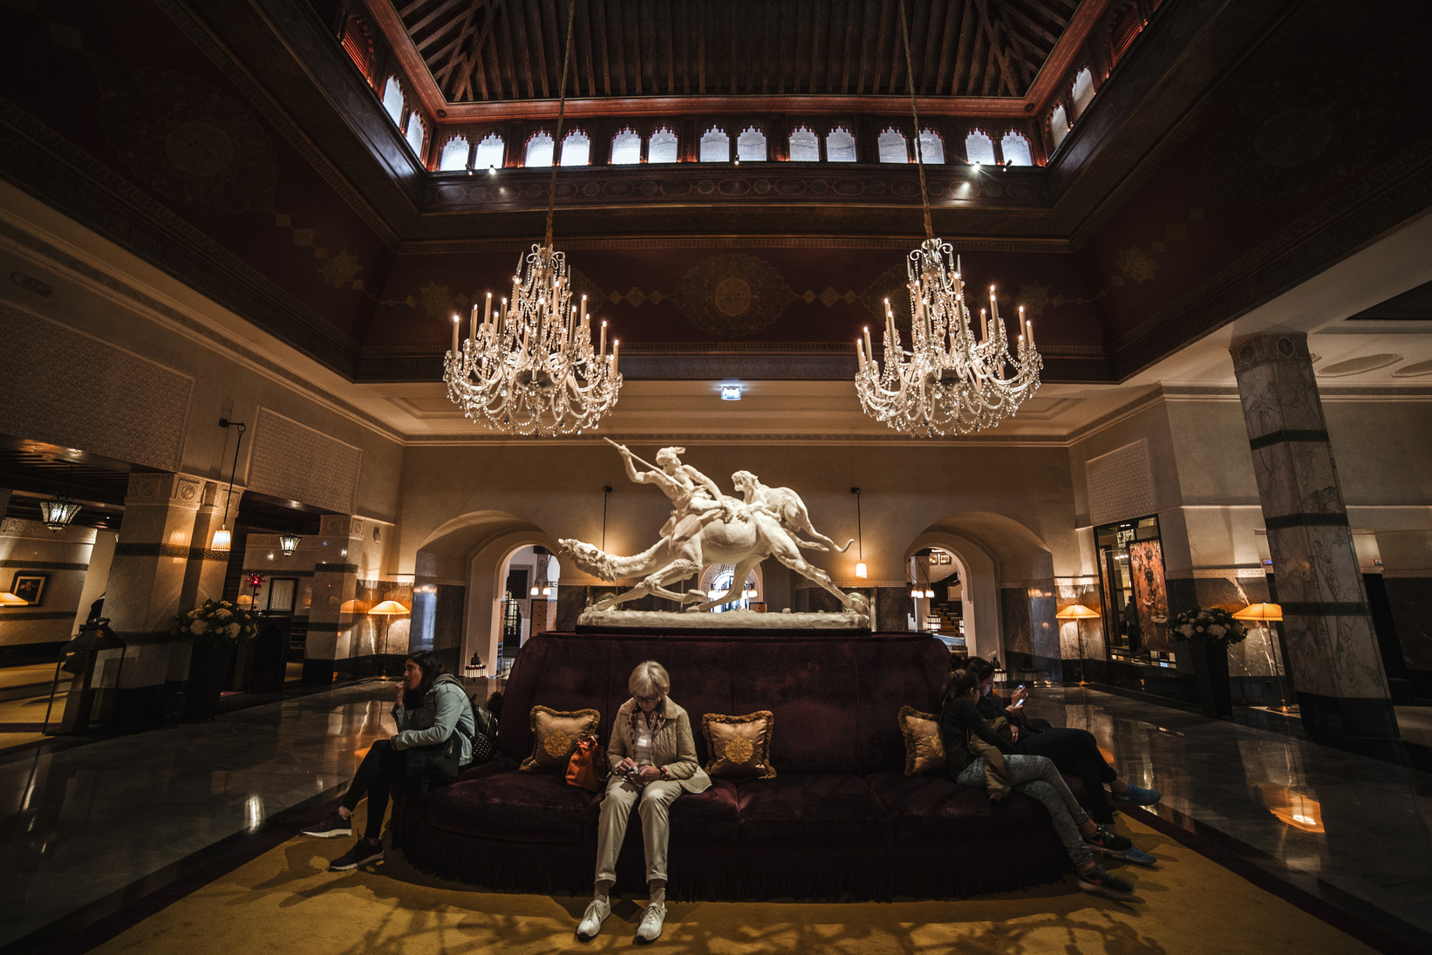
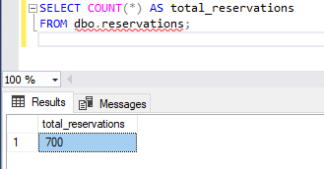
Home
Service
About Us
Contact
Total number of reservations
The total number of reservations made in the hotel was 700 reservations
05

Slide 7
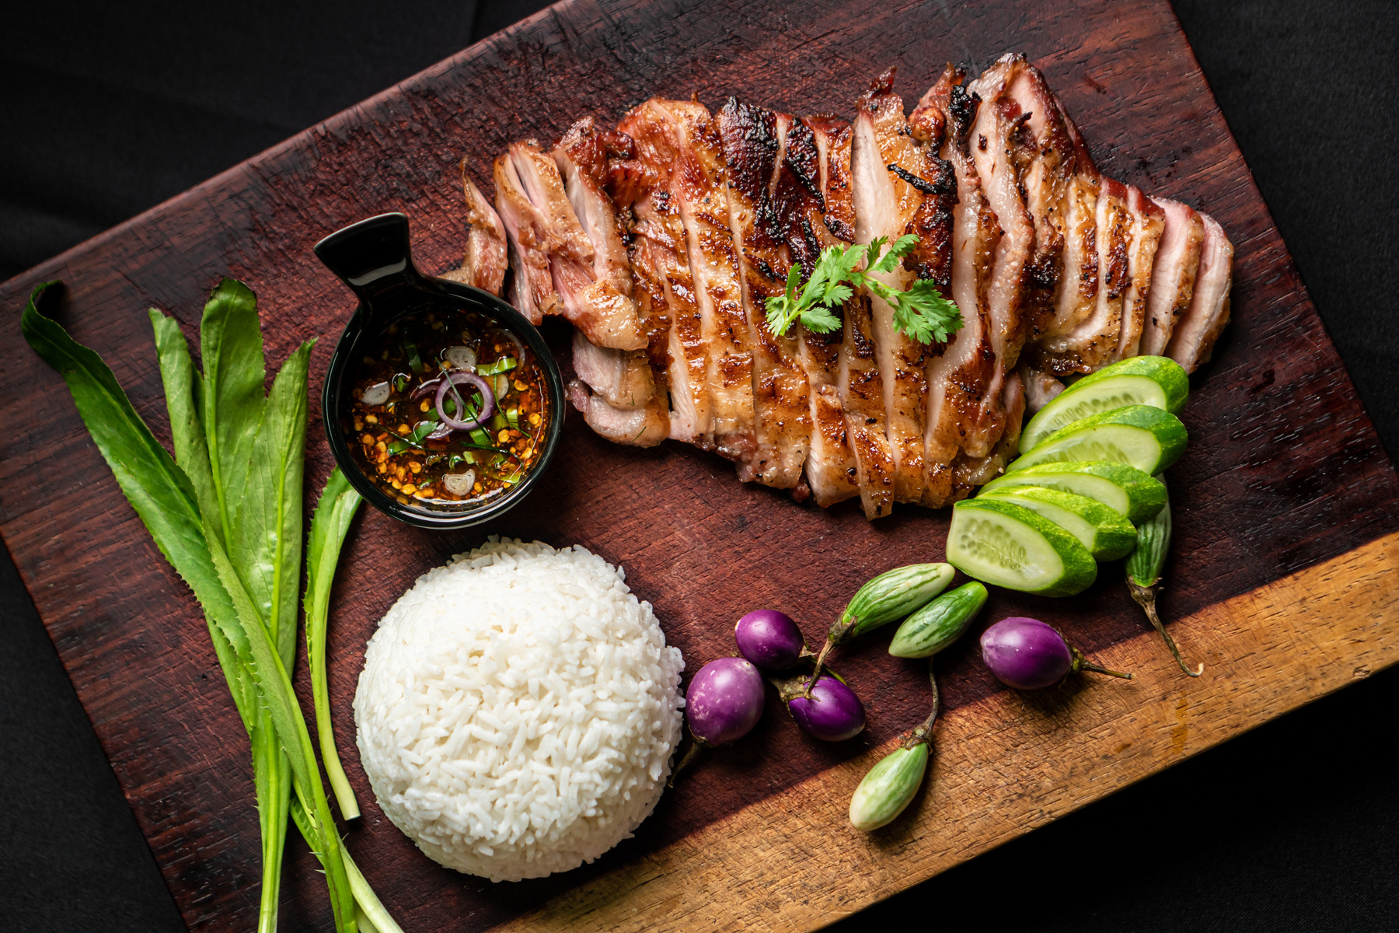
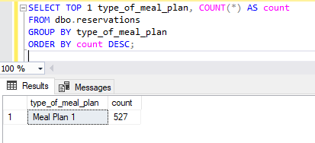
Home
Service
About Us
Contact
Meal plan most popular among guests?
Meal Plan 1 was the most preffered meal plan by the hotel guests
06

Slide 8
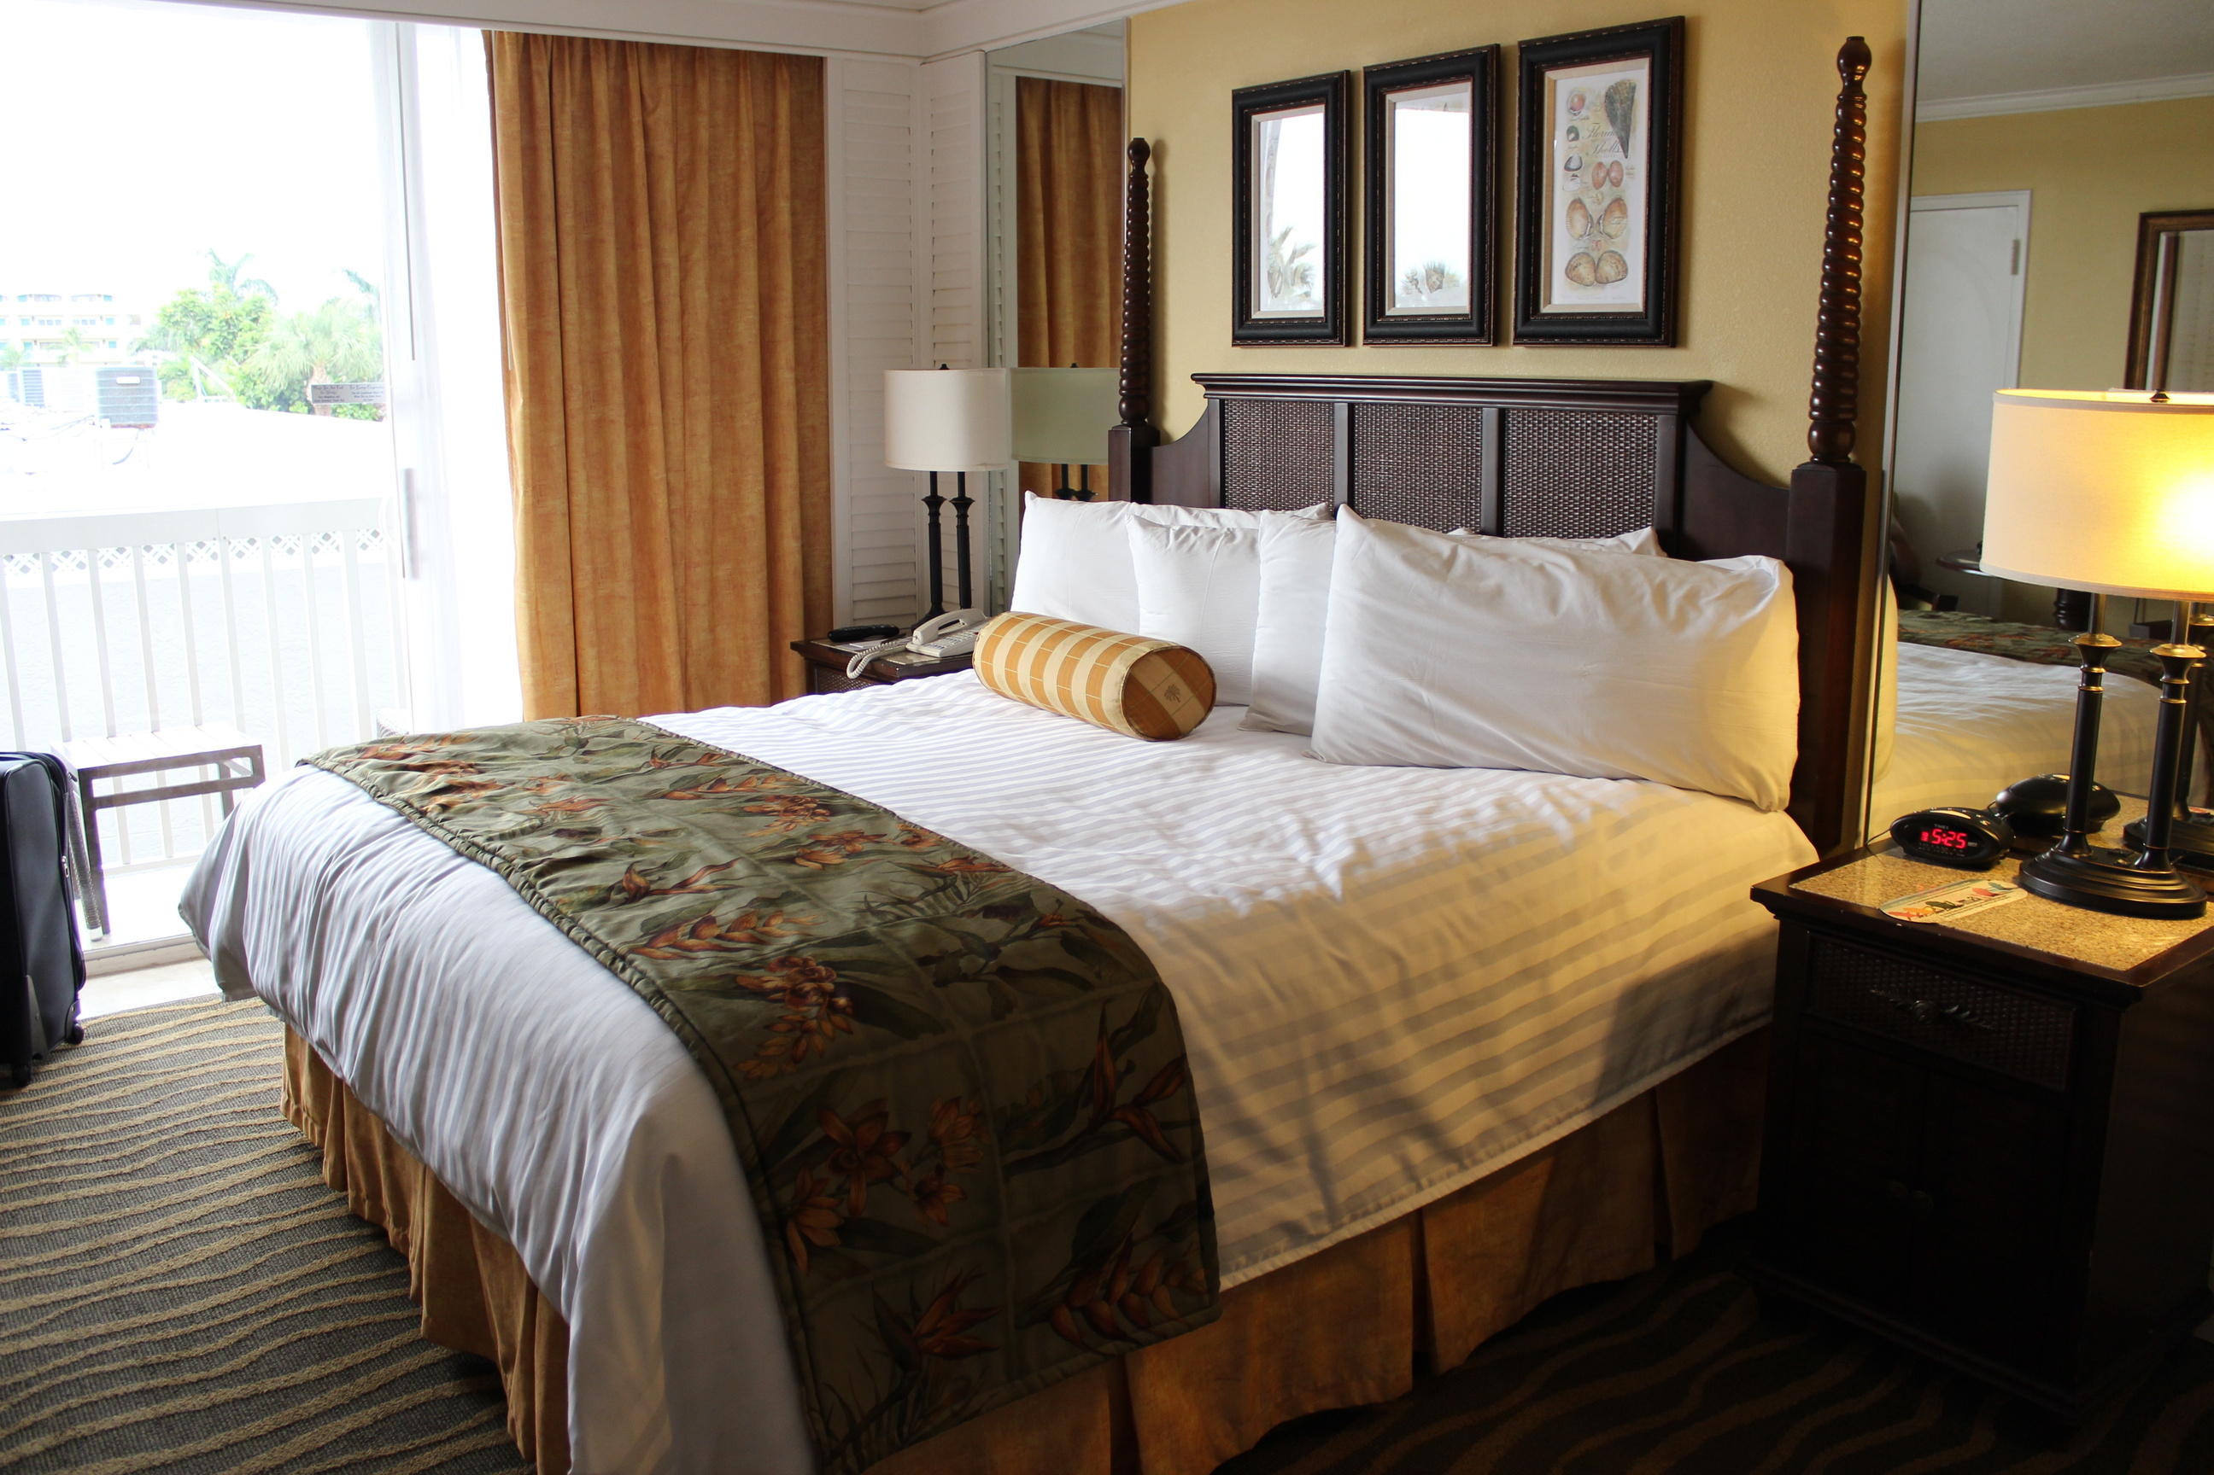
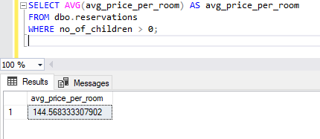
Home
Service
About Us
Contact
Average price per room for reservations involving children?
The average price per room for the all the hotel rooms was $144.57
06

Slide 9
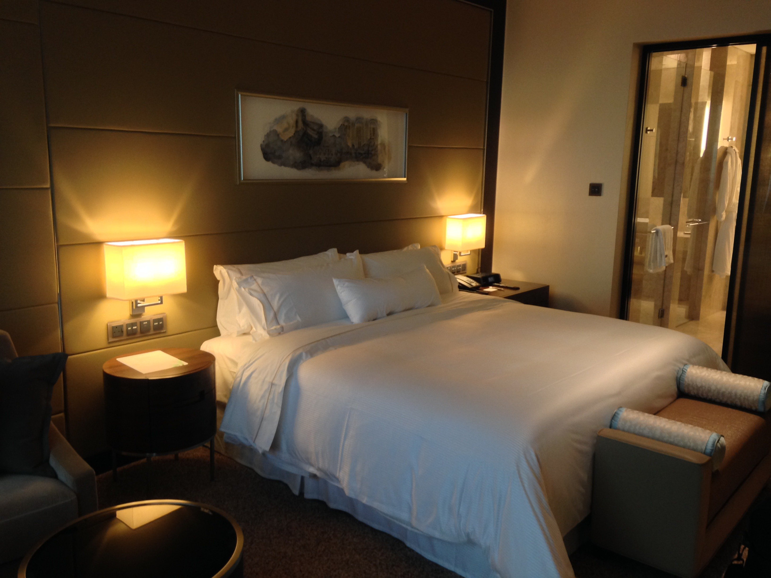
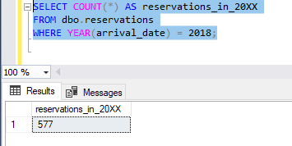
Home
Service
About Us
Contact
Reservations were made for the year 2018
Reservations made in the year 2018 was 577 in number
ROOM 03
07

Slide 10
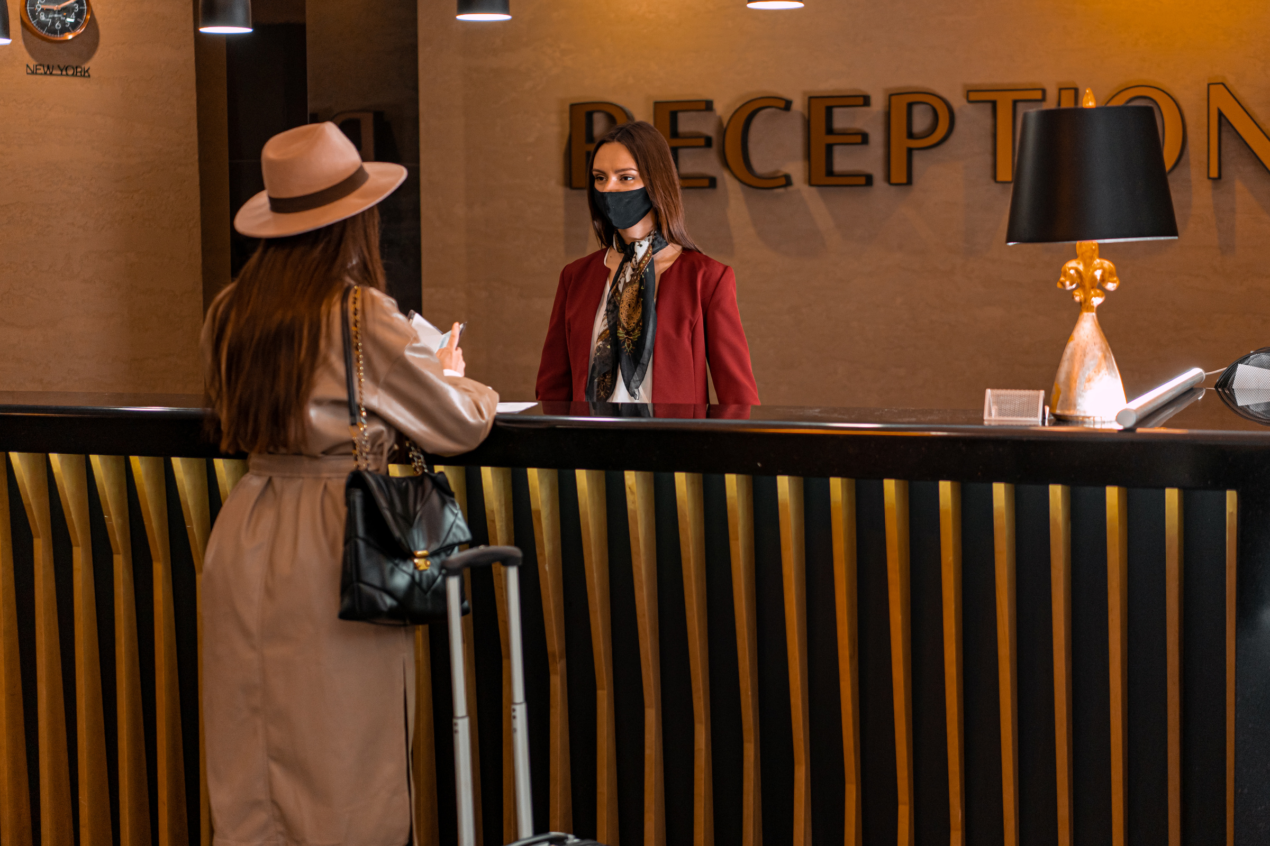
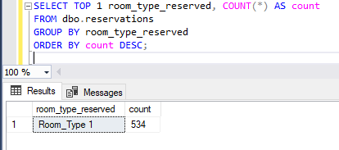
Home
Service
About Us
Contact
Most commonly booked room type?
room type 1 was the most commonly booked room type preffered by the guests
08

Slide 11
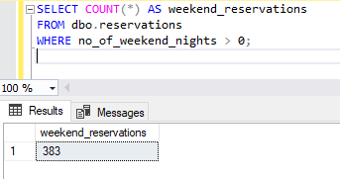
Home
Service
About Us
Contact
Number of reservations that fall on a weekend
383 reservations fall on a weekend
11

Slide 12

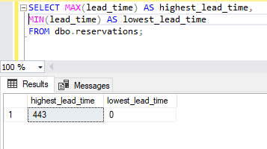
Home
Service
About Us
Contact
Highest and lowest lead time for reservations
The highest lead time is 433 while rhe lowest lead time is 0
10

Slide 13
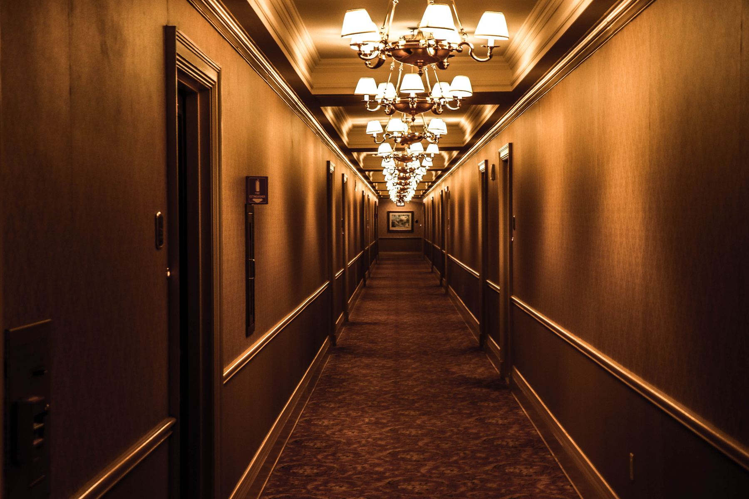
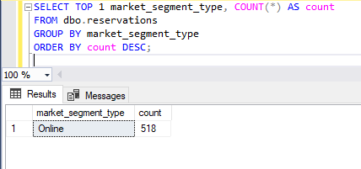
Home
Service
About Us
Contact
The most common market segment type for reservations?
The most common market segment type for reservation is online
10

Slide 14

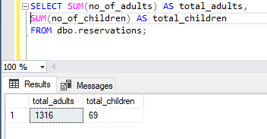
Home
Service
About Us
Contact
Total number of adults and children across all reservations?
The total number of adults is 1316 while the number of children is 69
10

Slide 15

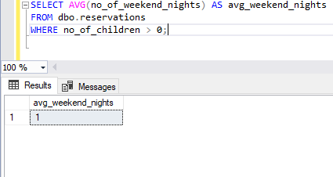
Home
Service
About Us
Contact
Average number of weekend nights for reservations involving children?
The avg number of weekend nights for reservations invloving children is 1
07

Slide 16
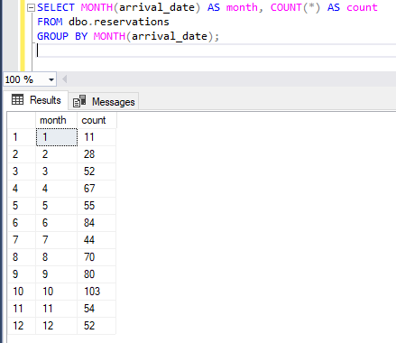
Home
Service
About Us
Contact
Reservations were made in each month of the year?
From the analysis October had the highest number of reservations while January had the lowest number of reservations
07

Slide 17
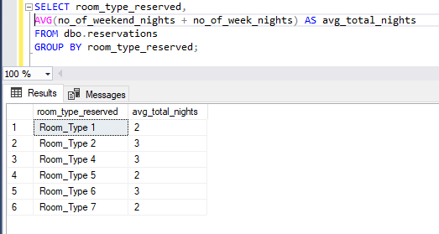
Home
Service
About Us
Contact
Average number of nights (both weekend and weekday) spent by guests for each room
type?
Room type 1 had an average of 2 nights spent by guest while 3 had 3 room type 4 3, room type 5 2 room type 6 had 3 with room type 7 had 2
ROOM 03
07

Slide 18
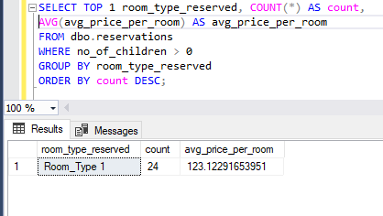
Home
Service
About Us
Contact
The most common room type, and what is the average
price for that room type?
ROOM 03
room type 1 was he most common with a count of 24 and an average price of $123.12
07

Slide 19
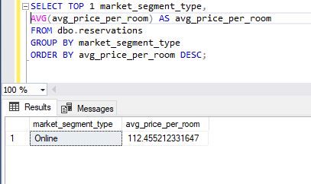
Home
Service
About Us
Contact
Market segment type that generates the highest average price per room.
ROOM 03
The online market segemnt generated the highest average pricrice per room with 112.46$
07

Slide 20
Conclusions
Reservation Patterns:
The total number of reservations made was 700.
Most reservations were made in 2018, totaling 577.
October had the highest number of reservations, while January had the lowest.
Guest Preferences:
Meal Plan 1 was the most preferred by guests.
Room Type 1 was the most commonly booked room type.
The most common market segment for reservations was online.
Pricing Insights:
The average price per room involving children was $144.57.
Room Type 1 had the most common room with a count of 24 and an average price of $123.12.
The online market segment generated the highest average price per room at $112.46.
Stay Duration and Lead Time:
The highest lead time was 433 days, while the lowest was 0 days.
Room Type 1 had an average of 2 nights spent by guests.
Other room types varied in the number of nights spent, with Room Type 3 and Room Type 6 having the highest average at 3 nights.
Weekend Stays:
383 reservations fell on a weekend.
The average number of weekend nights for reservations involving children was 1.

Slide 21
Recommendations
Marketing and Promotions:
Targeted Marketing: Focus marketing efforts on Meal Plan 1 and Room Type 1, which are the most preferred by guests. Use this data to tailor promotions and packages.
Seasonal Promotions: Create special promotions for the months with lower reservations, such as January, to boost occupancy during these periods.
Revenue Management:
Dynamic Pricing: Implement dynamic pricing strategies to adjust room rates based on demand, lead time, and seasonality to maximize revenue.
Optimize Online Sales: Since the online market segment generates the highest average price per room, invest in improving the online booking experience and consider partnerships with online travel agencies.
Operational Efficiency:
Resource Allocation: Adjust staffing and resource allocation to match the higher demand in October and weekends. Ensure adequate staffing during peak times to maintain service quality.
Lead Time Management: Develop strategies to manage reservations with high lead times effectively. Implement automated reminders and follow-ups to confirm bookings closer to the arrival date.
Customer Experience:
Family-Friendly Services: Given that reservations involving children have a higher average price per room, consider offering family-friendly packages and amenities to attract more families.
Personalization: Use data on guest preferences to offer personalized experiences. For example, guests who prefer Meal Plan 1 can be offered special deals on meal upgrades.

Slide 22
Home
Service
About Us
Contact
MENTORNESS
Thank You

